Slide 1
CSCI599: Life Simulator
Team: ZLX
Zhihan Zhang
Chuanzhe Li
Jia Xu

Slide 2
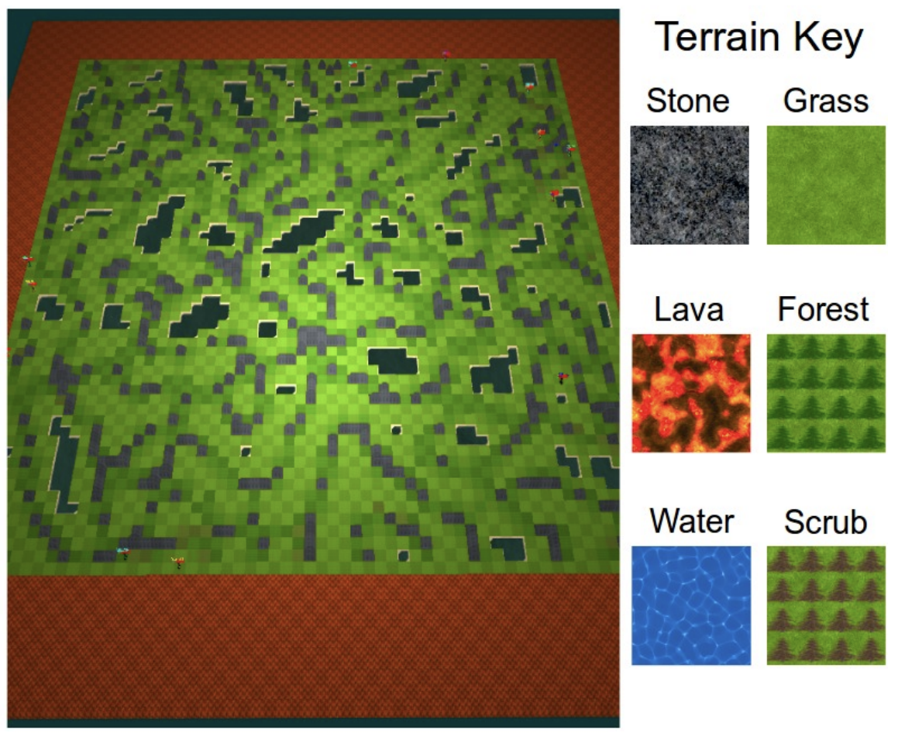

Introduction
Genre: Neural Massively Multiplayer Online Role-Playing Games (MMO)
Character: AI agents
Purpose: simulate the evolution of a large number of players competing to maximize survival time in a resource-limited environment
Map terrain:
Stone: inaccessible
Grass & Scrub: traversable
Lava: die once enter
Forest: traversable, get 5 points food, resource has 2.5% to regenerate
Water: inaccessible, can get water near it

Slide 3
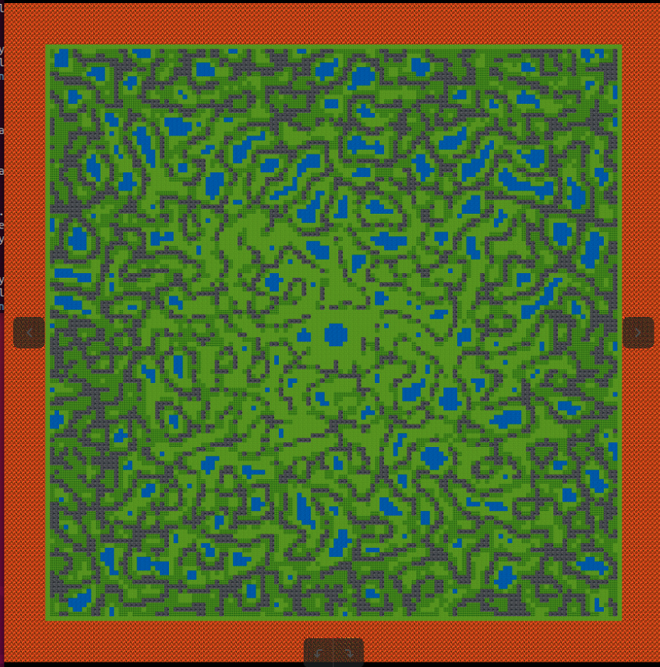
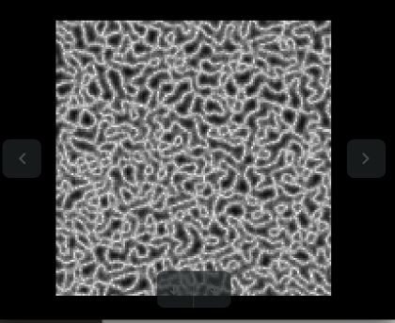
Introduction
Tile-based terrain map
Texture map

Slide 4
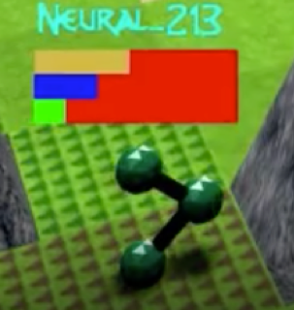
Introduction
Agent’s attributes:
Food: Agents die at 0 health (Yellow)
Water: Agents begin taking damage at 0 food or water (Blue)
Health: Agents begin taking damage at 0 food or water (Green)
Notes:
Basic gameplay: Similar to Civilization

Slide 5
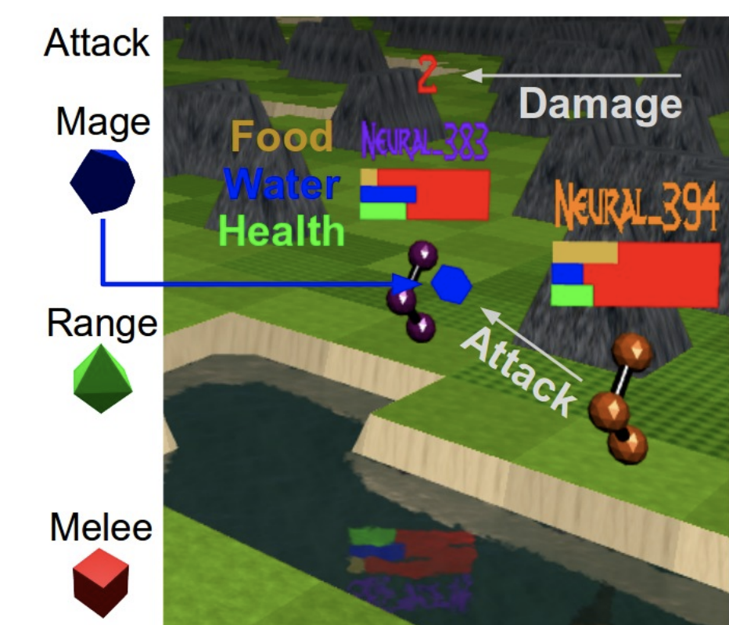
Introduction
Combat system:
Mage: Inflicts 10 damage at 1 range
Range: Inflicts 2 damage at 1-2 range
Melee: Inflicts 1 damage at 1-3 range and freezes the target in place, preventing movement for two ticks
Notes:
Basic gameplay: Similar to Civilization

Slide 6
How we build it

Slide 7
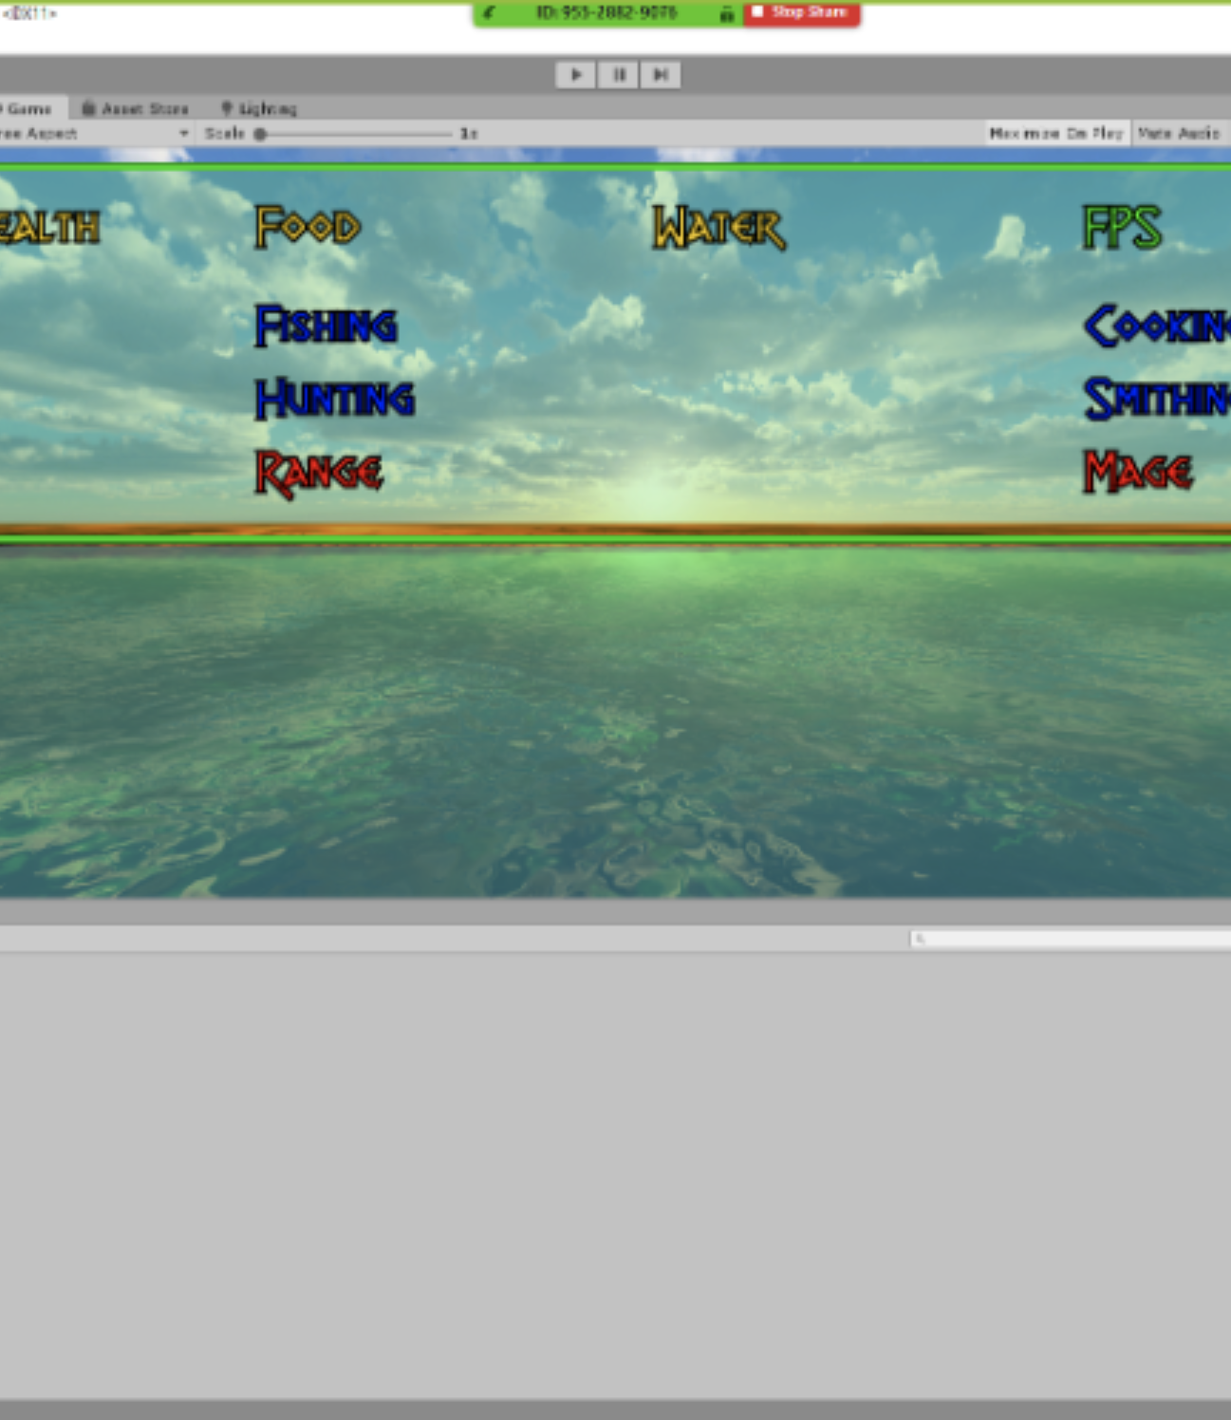
UI
Unity client UI is built with UI assets implemented by Unity hub
Optimized the network connection setting

Slide 8
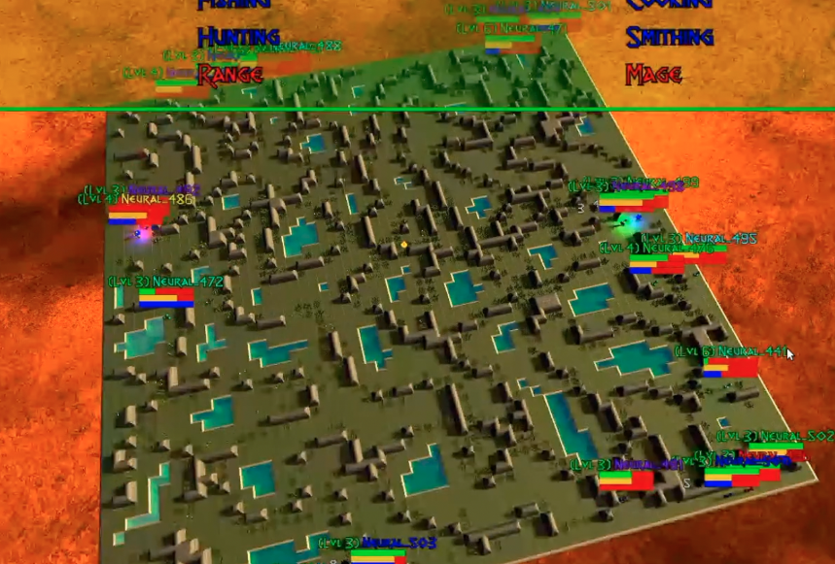
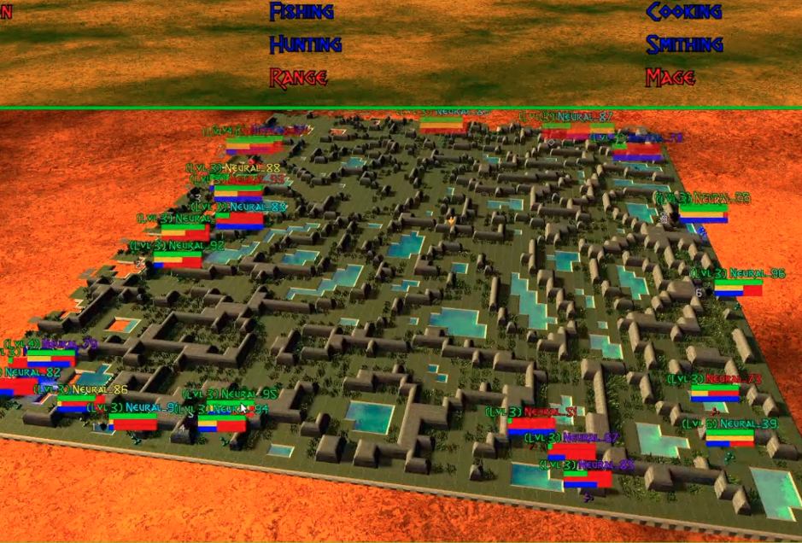
UI – changeable map size
Changed UI map drastically to support different size of maps with support to much more clients live in the same map
80 * 80
144 * 144

Slide 9
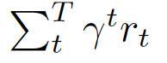
Architecture and Training – Define terms in our model
s_{t} : the current state of given agents given time tick t, state contains position information, current food, water, health etc.
o_{t} : the current observation based on one agent.
a_{t} : the action made by given agent which have five types, North, West, East, South, Pass
∏ _{θ}(a_{t}|s_{t}): Policy(fully observed)
τ: the trajectory of given agents which is a sequence of observation, action and reward. τ = ( o_{t}, a_{t}, r_{t}, …, o_{T}, a_{T}, r_{T} )
R(τ): reward given trajectory which is the sum of each survival one in every time tick with discount which by default is 0.99 R(τ) =
Notes:
Basic gameplay: Similar to Civilization

Slide 10
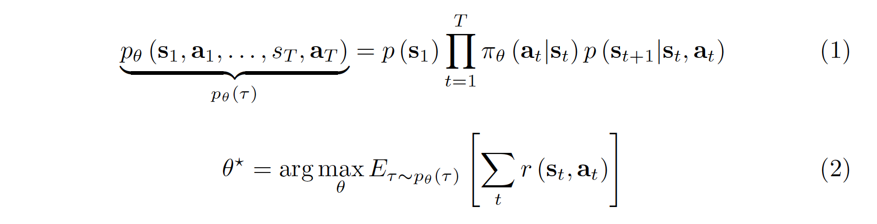
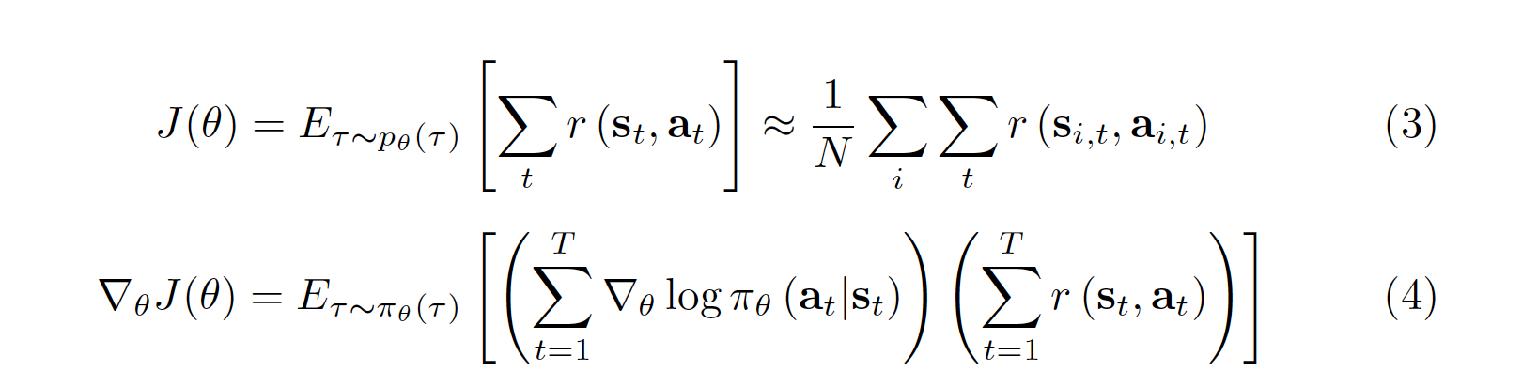

Architecture and Training – Training Steps
The purpose is to maximize the reward in given trajectory:
Here we want to optimize the learned parameters maximize the expected survival rewards by adopting policy gradient method:
We will update based on epoch:
Notes:
Basic gameplay: Similar to Civilization

Slide 11
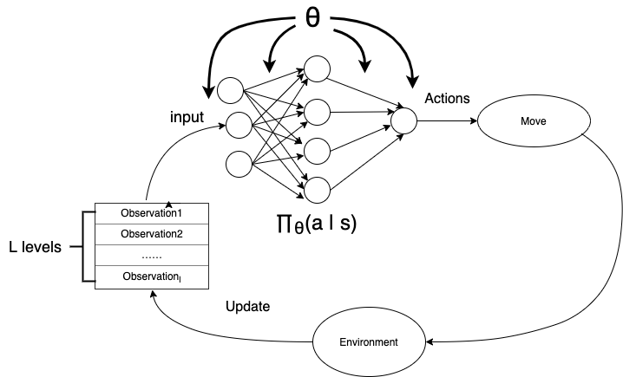
Architecture and Training -- Training model
Linear model
Use embedding and flatten agents’ reward to a one-dimensional encoded vector and fit it into a linear layer of with trainable parameters.

Slide 12
Architecture and Training -- Training model improvement tried
Tried many different network layer architectures to optimize the training speed and the performance of agents after training:
LSTM layers
Attention layers
Transformer

Slide 13
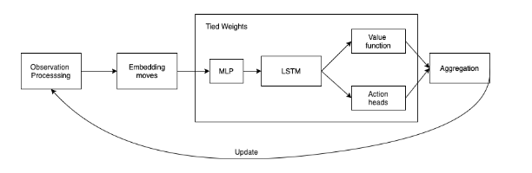
Architecture and Training -- Training model improvement tried
Model with LSTM:
LSTM is widely used in Time series data prediction, thus we want to using it to explore the action in a time-serial based trajectory

Slide 14
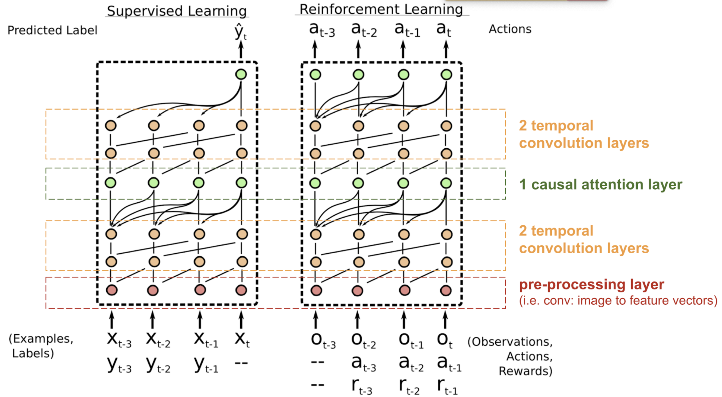
Architecture and Training -- Training model improvement tried
Attention:
Achieve better decision making by adopting global level understanding to the whole trajectory.

Slide 15
Architecture and Training -- Training model improvement tried
Transformer:
Neural machine translation may be applicable to our neural network because trajectory information may be viewed as a foreign language sentence.

Slide 16
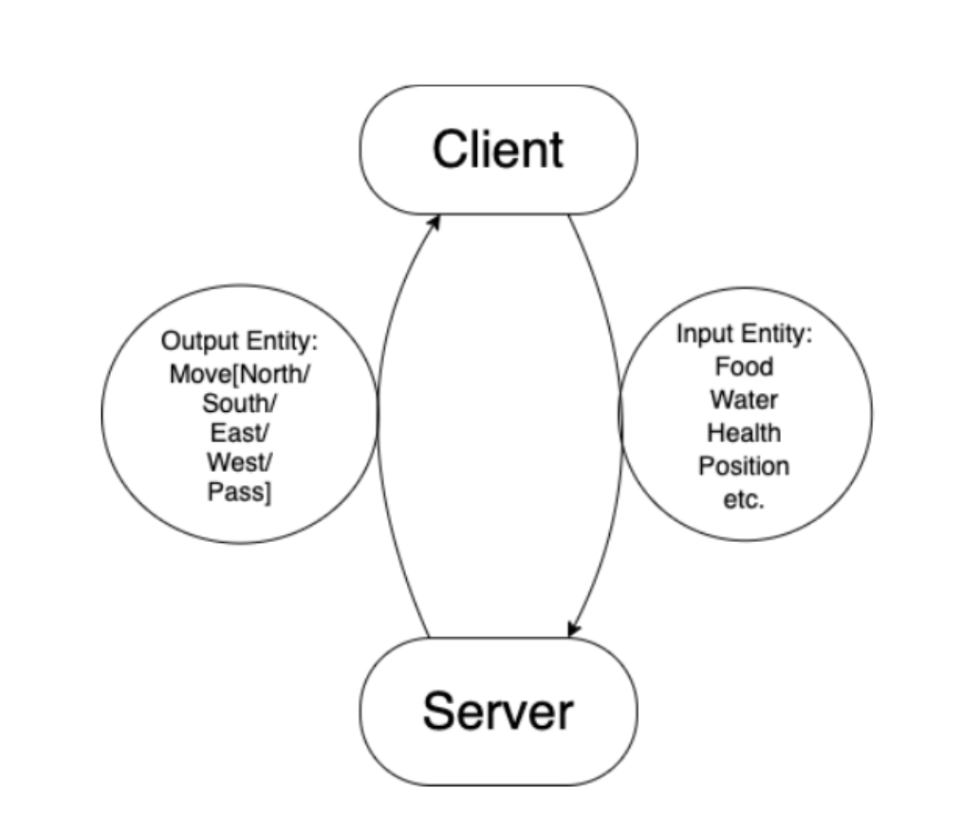
Communication network -- Basic network architecture
Use Twisted Network Library to communicate packet information between client and server

Slide 17
Communication network -- scaling network with parameter server
The initial training model with a single-layer neural network took several days to get results.
Consider methods to optimize the algorithm by distributing training to different processes and utilizing the computing resources completely.
The key principle of parallel computing is to overlap computation and communication to avoid high latency.
Using a parameter server helps us to solve this problem

Slide 18
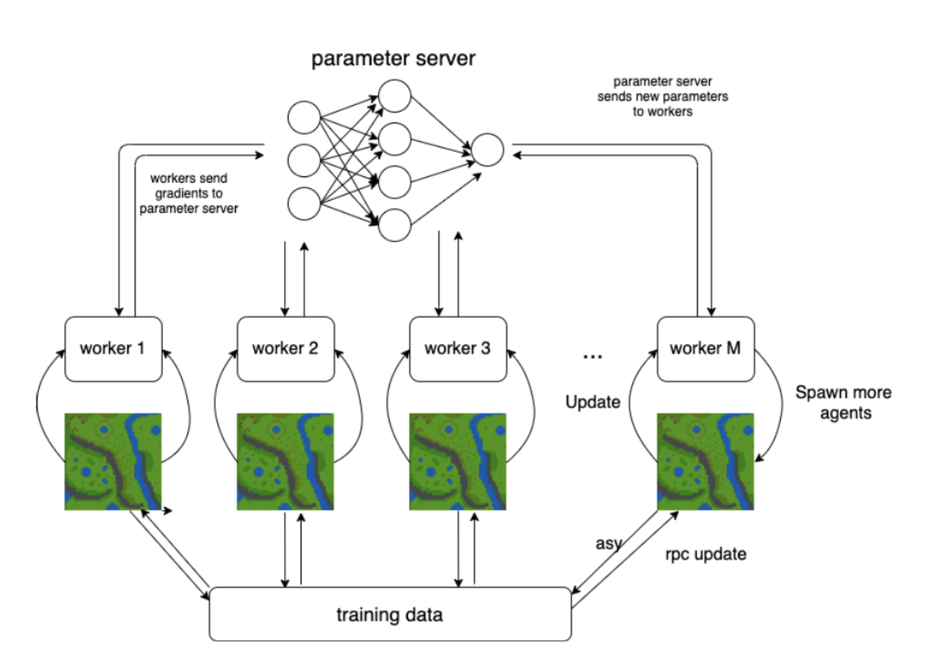
Communication network -- scaling network with parameter server
Step 1: The param server get the parameters computed and pushed by workers
Step 2 : Param server Broadcasts its updated parameters to all the other worker machines
Step 3: Workers use the updated parameters to compute gradients.

Slide 19
Communication network –- Implement parameter server with Ray
What’s Ray? -- A high-performance distributed framework for large-scale machine learning and reinforcement learning applications.
Why Ray? –- To simplify the development of high-performance distributed application that runs efficiently on a cluster.

Slide 20
Communication network –- Implement parameter server with Ray
With the Ray framework, we implement the parameter server pythonically in only a few lines of code, also, it allows us to scale our algorithm that runs on a laptop into a high-performance distributed application that runs efficiently on a cluster with lightweight APIs

Slide 21
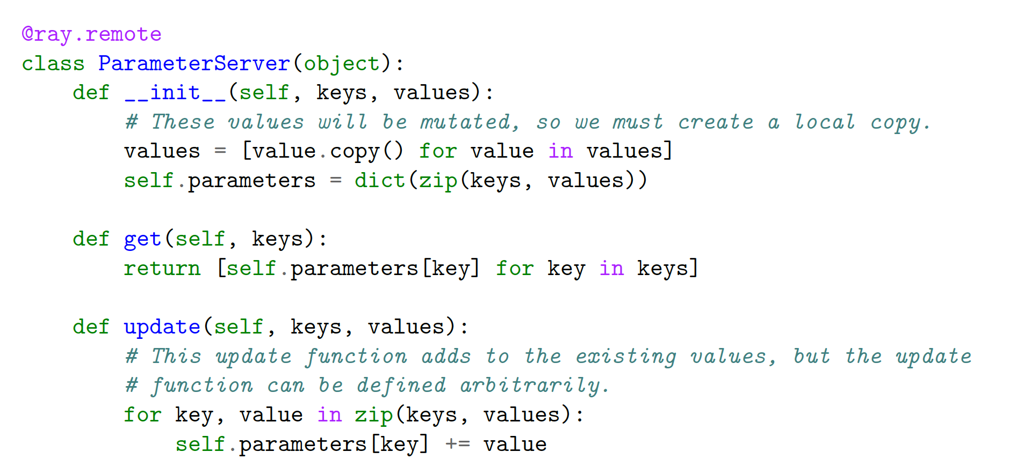
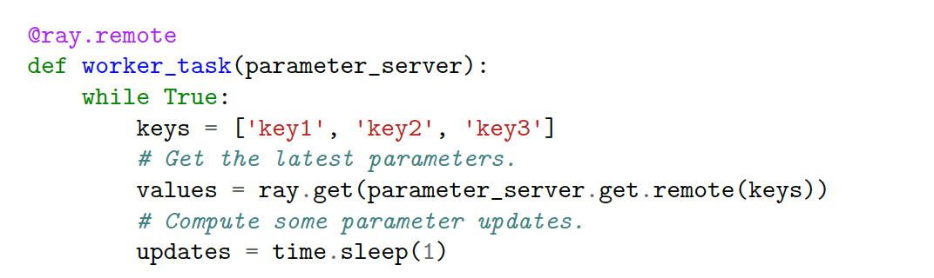
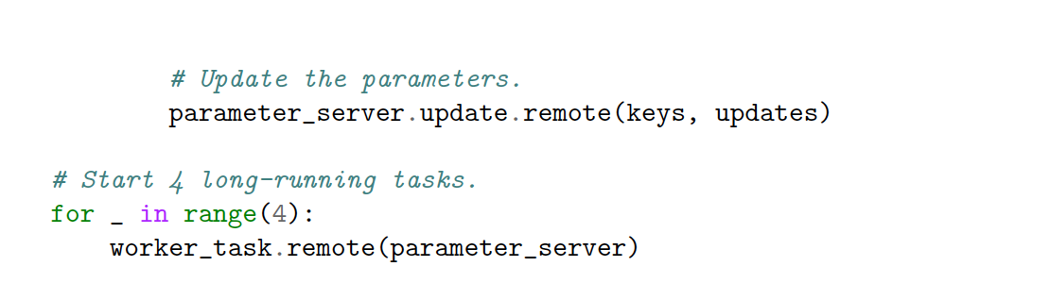
Communication network –- Implement parameter server with Ray

Slide 22
Communication network –- Implement parameter server with Ray

Slide 23
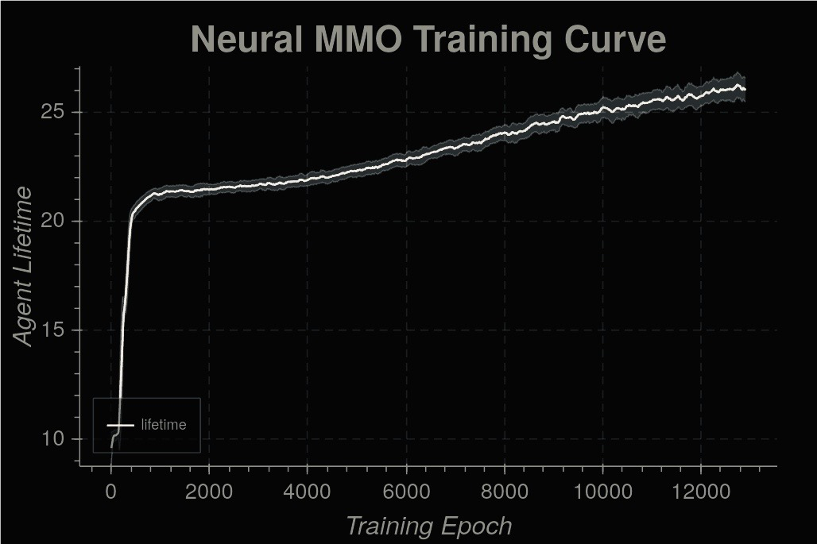
Training result and analysis
The baseline model gets to on average > 28 lifetime after training for several days on 12 cores.
Agents do learn something after training, like not to run into lava first, as indicated by the steep initial learning curve slope.

Slide 24
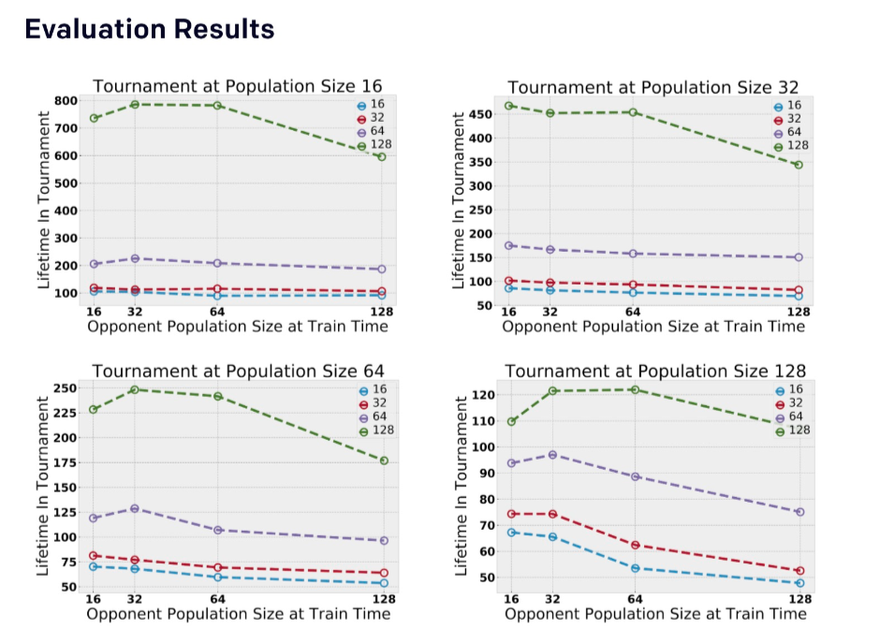
Training result

Slide 25
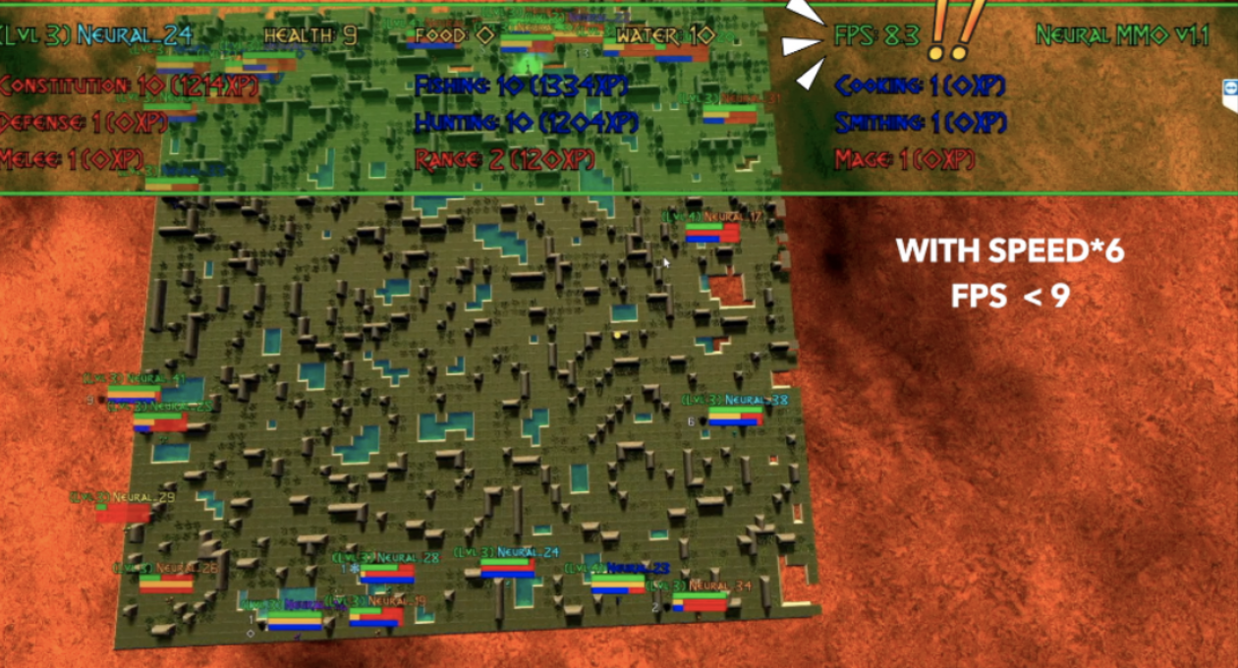
Limitation
Map size rendering optimization (currently the model FPS drop drastically if size become 500*500) (show later in the demo)

Slide 26
Future Work
Map size rendering optimization
Add more terrain setups and explore of environment complexity on population behavior (like will people can choose to live near river and generate collaboration instead of competition)
Deploy AI training to cloud and realize cloud native AI training, deployment and visualization pipeline

Slide 27
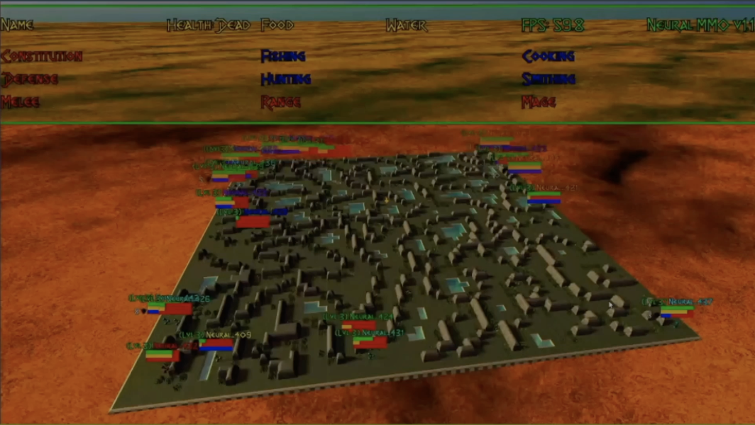
Demo

Slide 28
Thank you !

